Slide 1
IEEE IC HACK 2.0
EMISSIONNIX APP
Problem statement :- open innovation (climate change)

Slide 2
INTRODUCTION
Vehicle pollution and climate change is not only an ethical responsibility but also a matter of self-interest for individuals, communities, businesses, and governments. It is essential for protecting the planet, public health, and the well-being of future generations while fostering economic growth and innovation.

Slide 3
AGENDA
1. Idea overview
2. Solution overview
3. Market prospects
4. Future scope
5. Technical overview
6. Execution
7. Conclusion

Slide 4
IDEA OVERVIEW:
Environmental Impact: Vehicle pollution emits greenhouse gases (GHGs) such as carbon dioxide (CO2) and other pollutants into the atmosphere, particularly emissions from internal combustion engines. These pollutants are significant contributors to climate change, resulting in rising global temperatures, more frequent extreme weather events, and ecological damage.
According to the 2021 research, approximately 250 million registered automobiles in India are more than 15 years old, damaging our environment and playing a significant role in climate change.

Slide 5
SOLUTION OVERVIEW
We are creating a user-friendly, secure app in which users and transportation regulatory organizations such as RTOs can register themselves.
This app will aid in raising public awareness about how the black polluted poisonous fumes emitted by old automobiles pollute our environment . As a result, it will reduce the workload of authorities in locating such vehicles and preventing them from travelling the road.
Basically, it can be claimed that this application aids in lowering carbon footprints and reaching the SDGs.

Slide 6
MARKET PROSPECTS
. Consumer Awareness: Educating customers about climate change, pollution, and the advantages of eco-friendly transportation options can entice them to make more sustainable selections.
. Data and Analytics: Our app may collect useful information on vehicle emissions, usage trends, and carbon savings. This data can be monetized by selling it to relevant parties like as politicians, researchers, and car firms interested in developing greener technology.
. Partnerships & Alliances: Collaborating with environmental organizations, government agencies, and eco-conscious enterprises can aid in the promotion and credibility of our app.
. Monetization strategies: It includes in-app adverts, collaborations, and the provision of a premium edition with enhanced features.
. User Management: Encourage user participation by using gamification, awards, or challenges tied to eco-friendly behavior. Engaged users are more likely to keep using and promoting our software.

Slide 7
FUTURE SCOPE
. Climate Awareness : Our app that assist users in complying with these restrictions will remain relevant, and in some locations, may even become essential.
. Integration with other technologies: Technological advancements such as enhanced vehicle sensors, IoT connectivity, and artificial intelligence can improve your app's capabilities. Real-time pollution monitoring and predictive analytics, for example, might become more accurate and accessible.
. Global Expansion: If our app is effective in one region, we may consider spreading to other areas with similar environmental challenges. Climate change is a worldwide concern, and the app's utility may transcend beyond its local context.
. Data and Insights: Because our app collects data on emissions, vehicle usage trends, and user habits, it can be a significant resource for regulators, researchers, and automotive firms. This component of data monetization has the potential to provide additional revenue sources.

Slide 8
TECHNICAL OVERVIEW
Front-End Development:
Programming Languages: JavaScript, HTML5, CSS3
Framework/Library: React, Angular, or Vue.js for building the user interface (UI)
UI Design: Design tools like Adobe XD, Sketch, or Figma for creating user-friendly and visually appealing interfaces
Back-End Development:
Programming Languages: Node.js, Python, Ruby, Java, or PHP
Web Framework: Express.js (for Node.js), Django (for Python), Ruby on Rails (for Ruby), Spring (for Java), Laravel (for PHP)
Database: Options include MySQL, PostgreSQL, MongoDB (for NoSQL), or other relevant databases.
Server: Deploy our back-end on a cloud platform like AWS, Azure, Google Cloud, or use a managed platform like Heroku or Vercel for ease of deployment and scalability.
APIs: Implement APIs for data retrieval, real-time updates, and integration with external services and data sources
Geolocation and Mapping:
geolocation APIs and mapping services (e.g., Google Maps API, Mapbox) to track and display vehicle locations, routes, and pollution levels.
Cloud Services:
cloud services for scalability, data storage, and hosting. Popular cloud providers include AWS, Azure, and Google Cloud.

Slide 9
EXECUTION
Registration of the users & the agencies like RTO in the app using recognized forms of identification.
The app's GPS image capability will assist the agency in ensuring that the information provided by the user is not deceptive.
3. The agencies can take the required measures against the vehicle owner.
4. The vehicle data will be collected and saved as a reference to ensure that the needed vehicle is not observed on the streets.
There will be proper data analysis of the users as well as the vehicles they sent images of, which will be tracked on a regular basis and their status will be reviewed by authorities.
Users who were discovered to have uploaded an accurate and maximum number of photographs will be rewarded with a certificate by the agencies, which will increase their social recognition and inspire them to promote this platform.
7. By using suitable encryption, data about users and agencies will be kept secure.

Slide 10
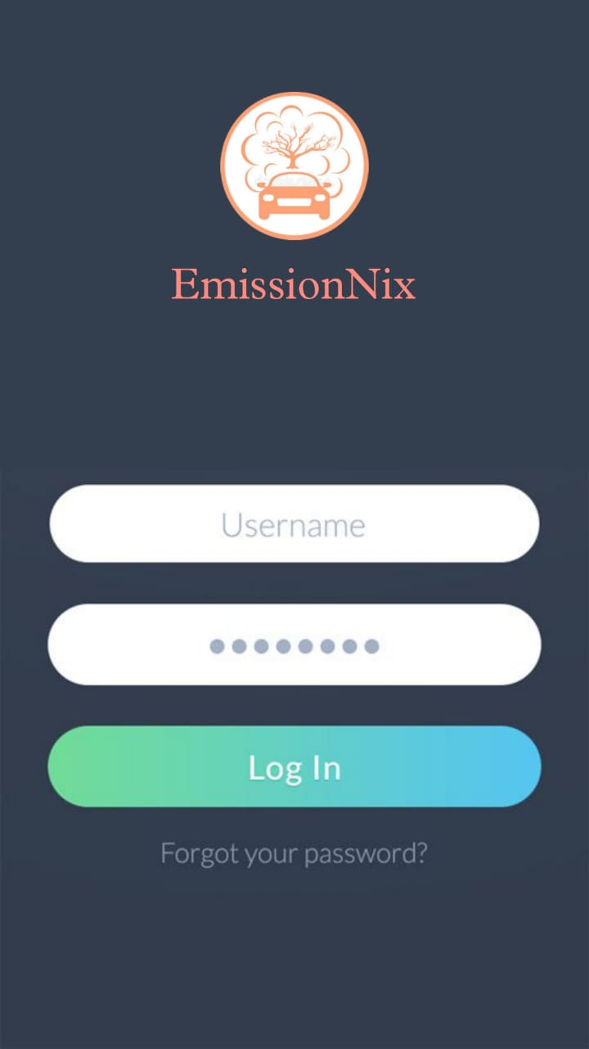
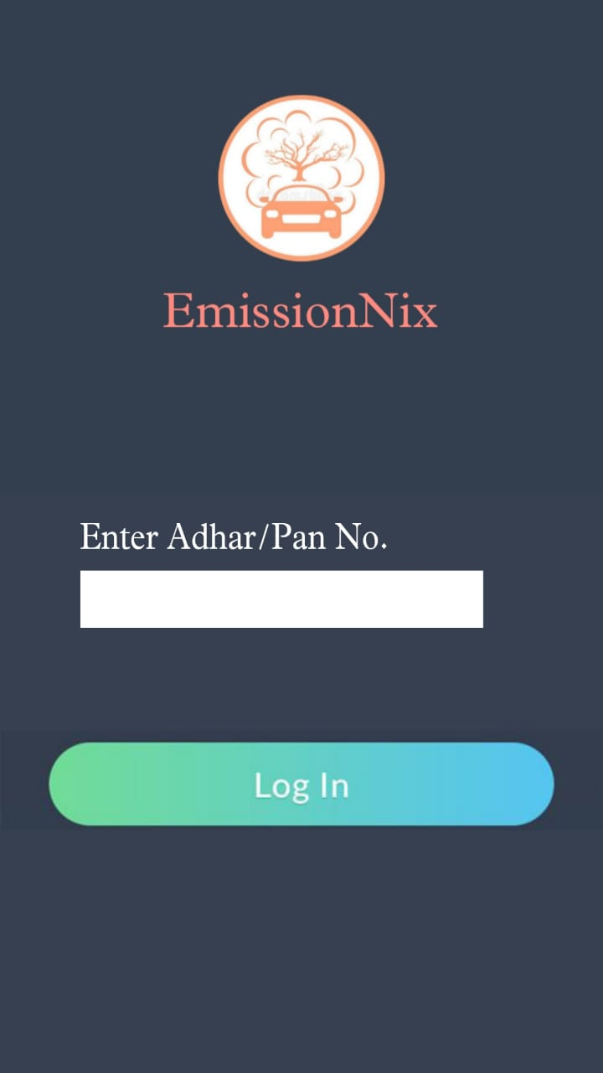
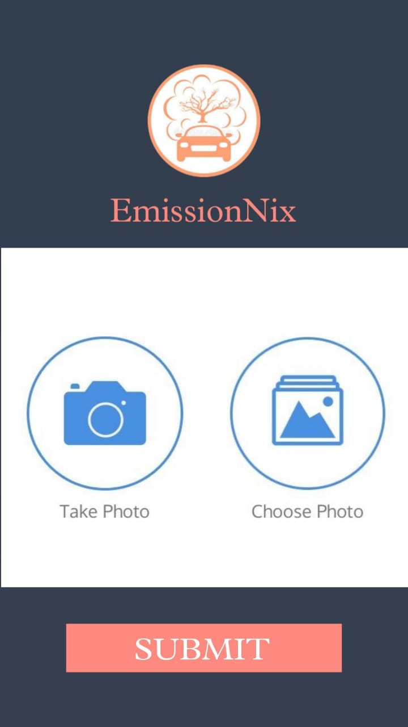
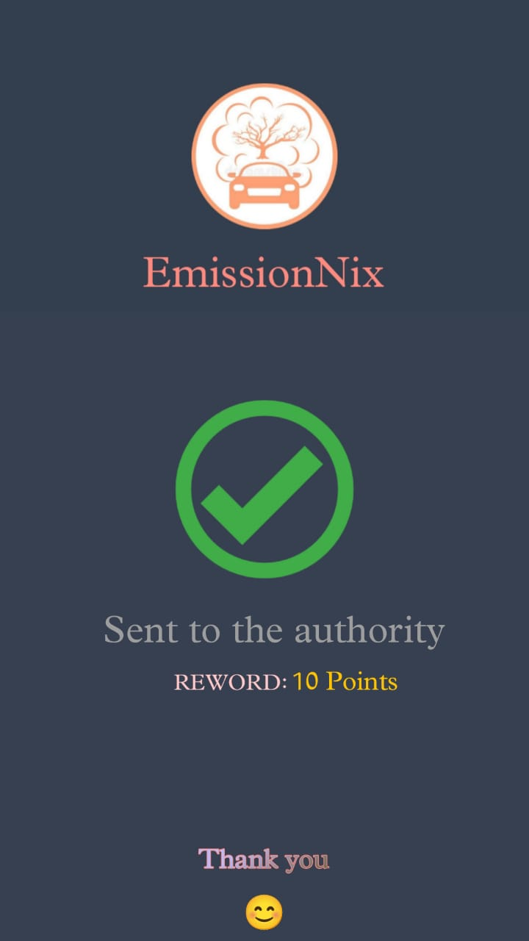
OUR PROTOTYPE
.
.
.

Slide 11
CONCLUSION
Thus, we are developing an app to reduce automobile pollution and raise awareness of climate change, which is a crucial step toward a future that is more sustainable and environmentally aware. The issues caused by climate change and vehicular pollution are significant, but they are not insurmountable. We all have the power to change things, protect the planet for future generations, and change our lifestyles to be more sustainable. By working together, we can reduce air pollution from cars, raise awareness of climate change, and pave the way for a brighter, greener future.

Slide 12
OUR TEAM
MARTINA MANASWINI SAHOO
BASUDEV DAS
Trident Academy Of Technology,
IEEE Student Branch
Mail id: martina.sahoo@gmail.com
Trident Academy Of Technology
IEEE Student Branch
Mail id: basudevv.2003@gmail.com

Slide 13
THANK YOU

